Slide 1
Password Generator using React.js
The "Password Generator" project is a web application built using React.js that allows users to generate strong and random passwords. It offers various options to customize the generated password based on the user's preferences.
Technologies Used:
React.js
JavaScript
HTML/CSS
Vishal Yadav
2110992059
G 19

Slide 2
Features: Password Length Selector: Allows the user to specify the desired length of the password. Character Set Selection: Provides options to include or exclude uppercase letters, lowercase letters, numbers, and special characters. Password Display: Displays the generated password to the user. Password Copy: Allows the user to copy the generated password to the clipboard. Password Strength Indicator: Provides feedback on the strength of the generated password.

Slide 3
Development Steps:
Project Setup:
Set up a new React.js project using Create React App or any preferred method.
Component Structure:
Create the necessary components for the password generator, such as App, PasswordGenerator, PasswordDisplay, etc.
State Management:
Manage the state of the password generator component to store user preferences and the generated password.
Password Generation Logic:
Implement the algorithm to generate random passwords based on user preferences. This involves selecting characters from the chosen character sets and arranging them randomly.
User Interface:
Create a user-friendly interface for the password generator, including input fields for length and checkboxes for character sets.

Slide 4
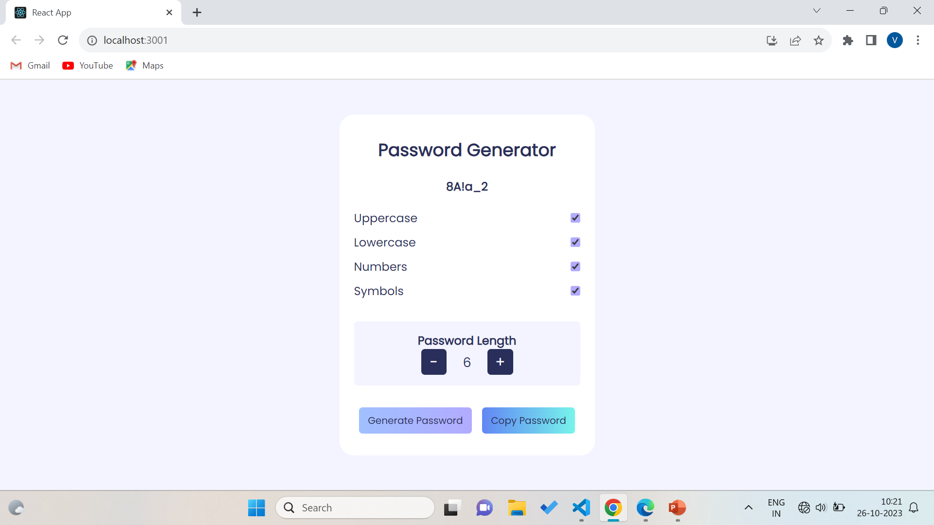
6. Password Display:
Develop a component to display the generated password and include a copy-to-clipboard feature.
7.Password Strength Indicator:
Optionally, you can integrate a password strength meter to provide feedback on the generated password's strength.
8.Testing:
Test the application thoroughly to ensure that it generates passwords correctly and handles user interactions as expected.

Slide 5
Function used in Project include:
useState hook to manage the state of the password and other variables.
import { upperCaseLetters, lowerCaseLetters, numbers, special } from "./data";
getRandom function returns a random character based on the user’s selected options.
The Math.random() method returns a random number from 0 (inclusive) up to but not including 1 (exclusive).
createCopy function creates a copy of the generated password and adds it to the clipboard.
generatePassword function generates a password based on the user’s input.

Slide 6
The getRandom() function you provided is a well-written and efficient function for generating random characters. It works by first creating an empty chars array.
Then, it loops through each of the four types of characters (uppercase letters, lowercase letters, numbers, and symbols) and adds a random character.
from that type to the chars array, if the corresponding checkbox is checked.
If no checkboxes are checked, the function returns an empty string. Otherwise, the function returns a random character from the chars array.
Here is a breakdown of the function:
const getRandom = () => {
// Create an empty array to store the random characters.
const chars = [];
// If the uppercase checkbox is checked, add a random uppercase letter to the array.
if (isUppercase) {
chars.push(
upperCaseLetters[Math.floor(Math.random() * upperCaseLetters.length)]
);
}

Slide 7
SUMMARY:
The user enters the desired password length and selects the types of characters to include in the password (uppercase letters, lowercase letters, numbers, and symbols).
The application generates a random password based on the user's selections.
The password is displayed to the user and can be copied to the clipboard.
Here are some of the benefits of using a password generator using React JS:
It is easy to use. The application has a simple and user-friendly interface.
It is secure. The application uses a cryptographic algorithm to generate random passwords.
It is extensible. The application can be customized to include additional features, such as the ability to save passwords to a password manager.

